Slide 1

State of the community address

Slide 2

KIM HALSEY
EXECUTIVE DIRECTOR

Slide 3


Slide 4
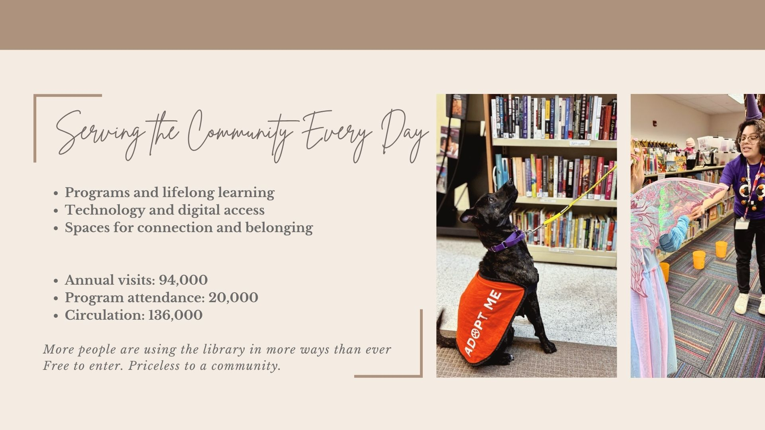

Slide 5
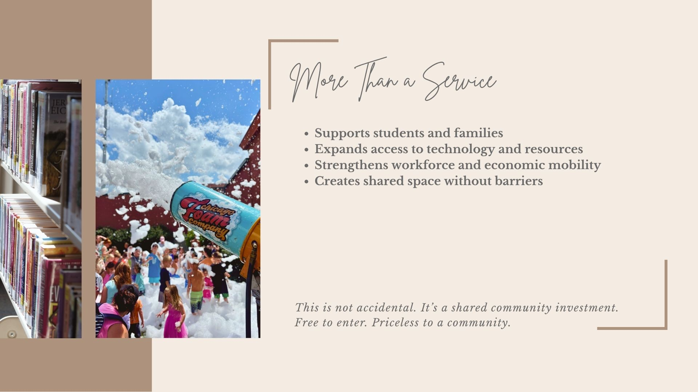

Slide 6
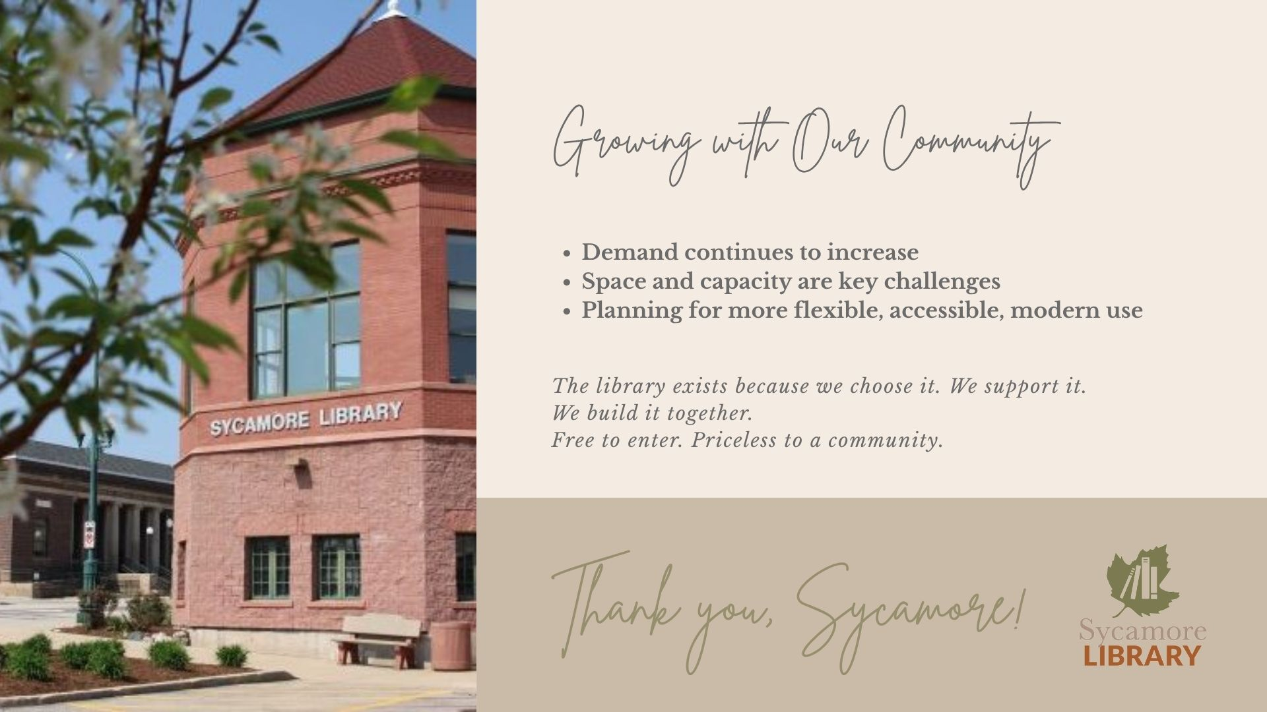

Slide 7

QUESTIONS?

Slide 8

DR. KRISTEN CAMPBELL
SUPERINTENDENT

Slide 9

OUR DISTRICT TODAY
Enrollment remains stable over time
Student achievement meets or exceeds state averages
Strong financial stewardship and long-term planning

Slide 10
10-YEAR DISTRICT ENROLLMENT

Slide 11
WE ARE SYCAMORE
More than numbers - this is our story.

Slide 12
2025-26 SCHOOL YEAR HIGHLIGHTS
Sycamore High School/SpartanTV featured on National TV for the Marquee Sports Network for the Community Showcase Football Game
Sycamore Middle School students participated in a Makers on the Move, celebrating STEM and CTE in our schools
Sale of previous Administration Center, 245 W. Exchange Street

Slide 13
2025-26 SCHOOL YEAR HIGHLIGHTS
Health Plan Transition for all staff resulting in $1.5 million in recurring savings
Superintendent Search
Approved Sycamore Education Association Contract through the 2027- 28 school year

Slide 14
STUDENT LEARNING & GROWTH
Learner-Centered practices
Curriculum implementation
Focus on growth, not just proficiency

Slide 15
SUPPORTING THE WHOLE STUDENT
Portrait of a Spartan in action across all schools
Focus on dispositions:
Problem Solvers
Effective Communicators
Empathetic
Flexible Thinkers
Collaborative
Confident
Resilient
Responsible

Slide 16
WHERE ARE WE HEADED
District Goal Setting and Strategic Planning
Implementation of the new English Language Arts curriculums
Elementary: Amplify CKLA
Grades 6-12: Savvas myPerspectives

Slide 17
QUESTIONS?

Slide 18

MELISSA AMEDEO
EXECUTIVE DIRECTOR

Slide 19
BUSINESS ATTRACTION/EXPANSION/RETENTION
Attraction
Manufacturing in Sycamore Prairie Business – 60 jobs within 2 years
Project Balsam – Manufacturing, Capital Investment $6.5M, 20 new jobs
Expansion
The Suter Company refrigerated line completion
Retention
Business Retention, Expansion (BRE) Committee setting up visits.
Email: Amedeo@dcedc.org to schedule

Slide 20

The Suter Company Celebrated 100 Years
“Makers on the Move” Tour stop
Notes:
The Suter Company in Sycamore continues work on their Refrigerated Line and also will be celebrating 100 years in 2025
Cole Pallet - Cole Pallet acquired the former SK Hand Tool building from IDEAL INDUSTRIES for a headquarters and manufacturing operation to support continued expansion for its specialized pallet business. Also houses their CoVar Transportation and AgOne firms.
Communities by Grainger- Old Mill Park ages 55+ residential units under construction in Sycamore on SEC of Mt Hunger Rd

Slide 21
Economic Outlook Luncheon – March 25th
SAVE THE DATE
AI & Automation -
Dr. Broady
Where: Kish
When: August 11,
9:00-11:00 AM

Slide 22
Mark Perna – Answering Why – Talent Pipeline

Slide 23
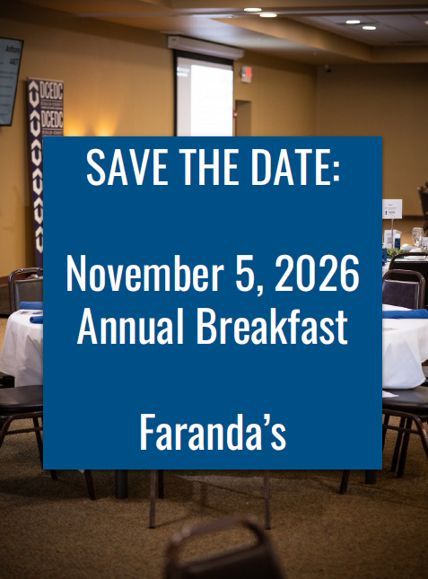
Upcoming Events – Save the Date

Slide 24
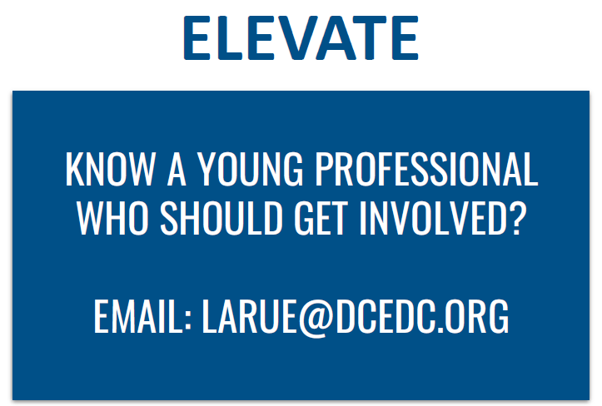
Promoting DeKalb County – Jessi Haish LaRue
Elevate Educates
March 3rd
Kelly shared insights for “Building Your Career on Purpose.”
Tanner spotlighted the power of LinkedIn.

Slide 25
Promoting DeKalb County – Andrea Van Drew
Illinois Enterprise Zone Association (IEZA) / IL Tax Increment Association (ITIA) Joint Conference
April 22nd and 23rd
Peoria
Sycamore Chamber Leadership Academy
2026 Class
Illinois Institute for Rural Affairs’ (IIRA) Community and Economic Development Conference
February 25th and 26th
Springfield

Slide 26
Promoting DeKalb County
International Economic Development Council (IEDC)
Co-Vice Chair, Women In Economic Development – Affinity Group
March – Leadership Summit in DC
October – IEDC Annual Conference in New Orleans
Women to Watch
Nominated by Jeff Keicher
April 22, 2026
Springfield

Slide 27

Thank you!
Melissa Amedeo
Executive Director
amedeo@dcedc.org
815.895.2711 ext. 203
Andrea Van Drew
Economic Development Specialist
avandrew@dcedc.org
815.895.2711 ext. 204
Jessi Haish LaRue
Marketing & Events Specialist
larue@dcedc.org
815.895.2711 ext. 201
www.DCEDC.org

Slide 28

QUESTIONS?

Slide 29


RUTH KEDZIOR
COUNTY ADMINISTRATOR

Slide 30
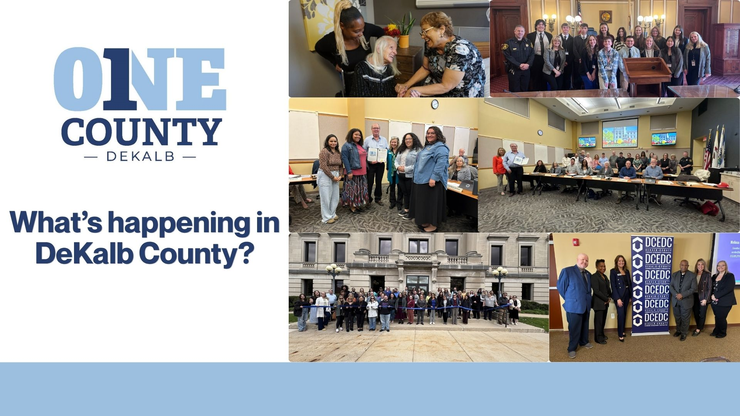

Slide 31
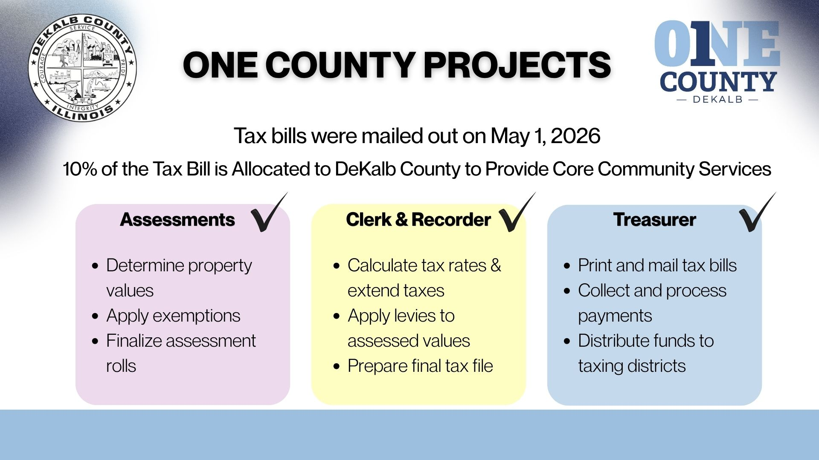

Slide 32
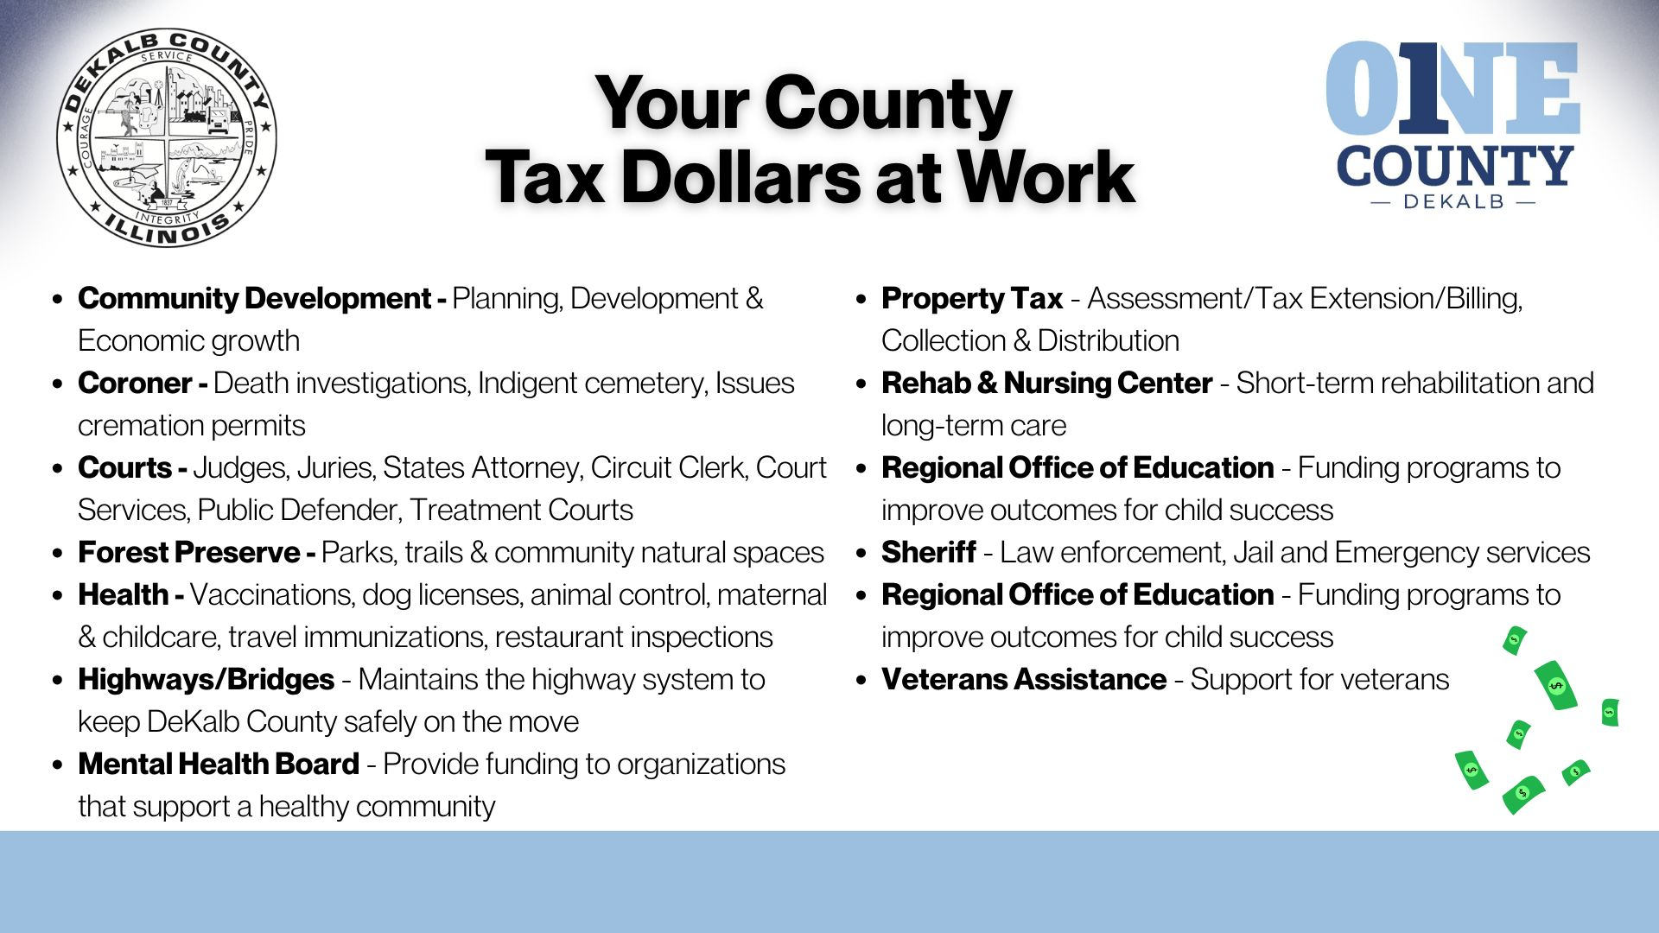

Slide 33
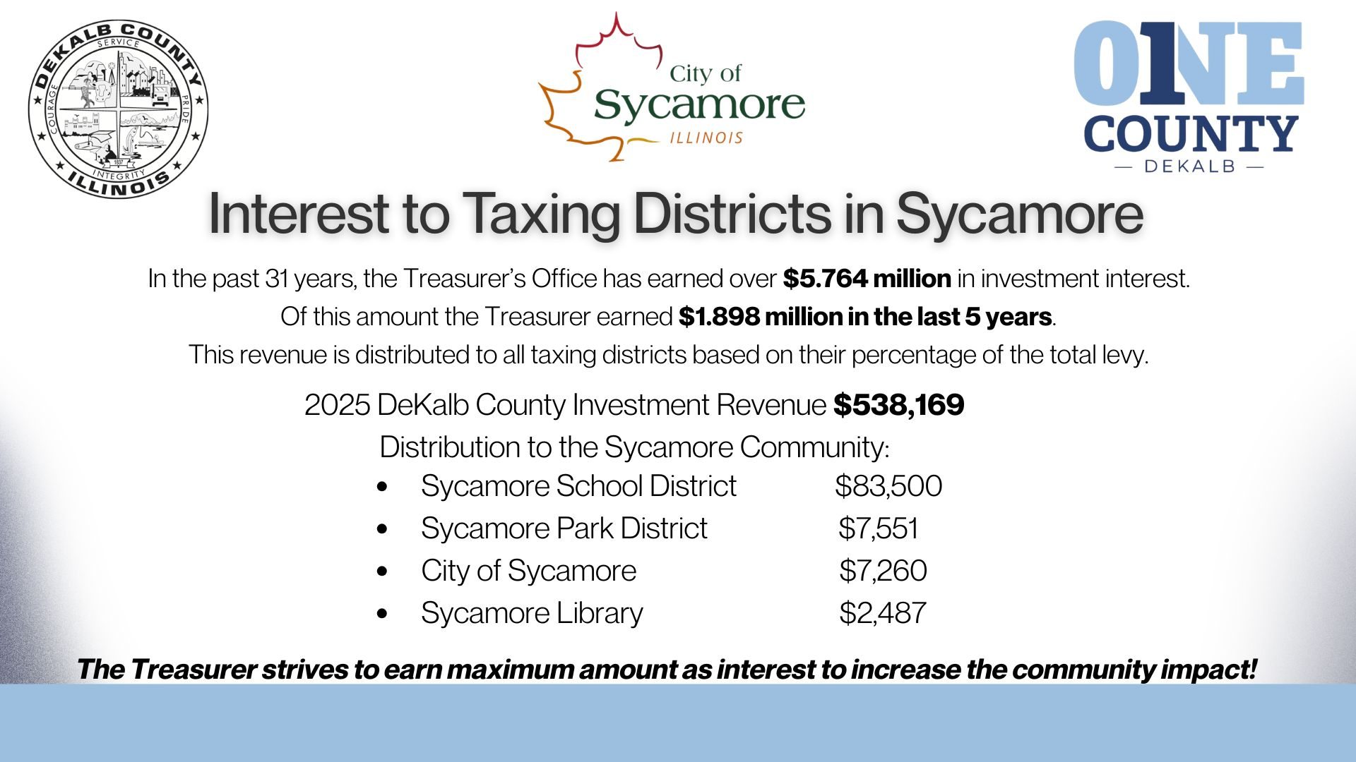

Slide 34
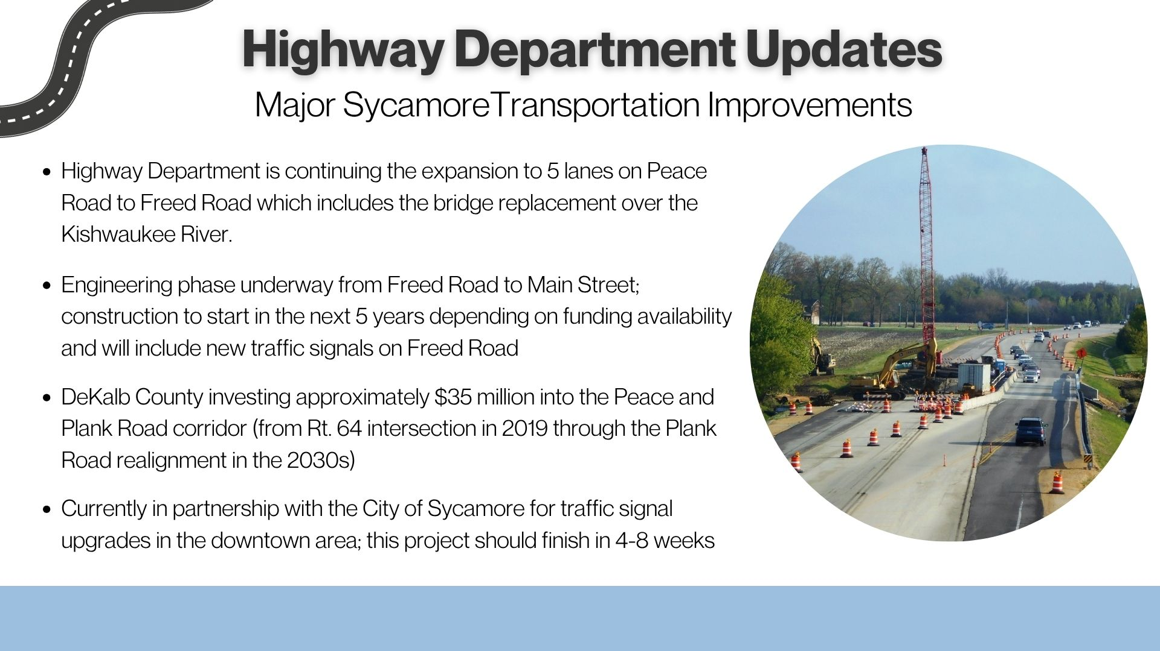

Slide 35


Slide 36


Slide 37
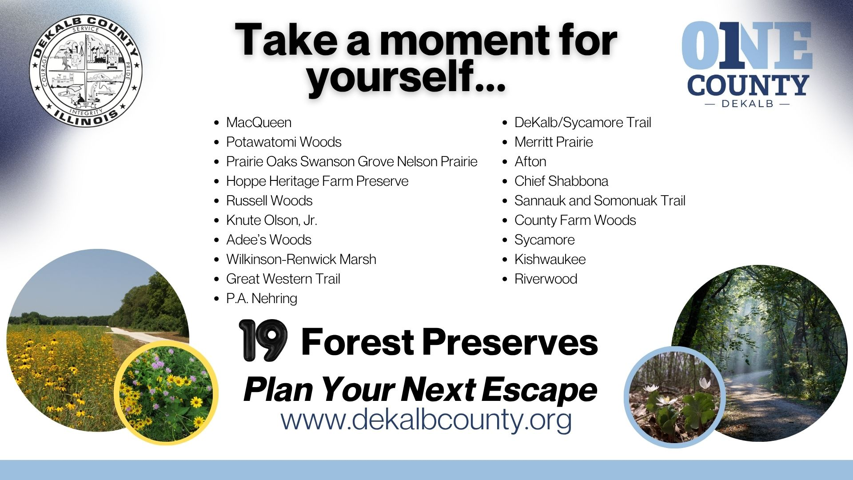

Slide 38


Slide 39
QUESTIONS?

Slide 40

MICHAEL HALL
CITY MANAGER

Slide 41
Long Term Financial Stability
Public Safety
Capital Infrastructure
Economic Development
Technology Improvements
Community Engagement
Six Core Objectives Guide the Work of the City

Slide 42

Long Term Financial Stability

Slide 43
City Revenues
Sales tax – not property tax – is the primary revenue driver

Slide 45
The Biggest Sales Tax Contributors
Seven businesses generate 20% of the City’s revenue
Menards
Meijer
Kunes Dealerships
Chevy Dealership
Farm & Fleet
Hy-Vee
Walgreens

Slide 46
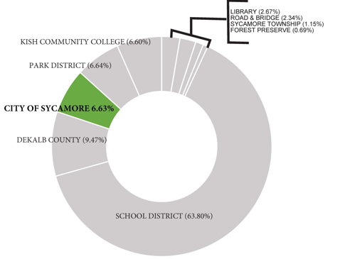
2025 Property Tax
The City is only 1 of 9 independent taxing bodies.

Slide 47
City Expenditures
The budget funds people providing services
& maintaining infrastructure.

Slide 48
General Fund budget of $25.3M broken out into cost centers
Roads 6%
$1.5M (GF)
$1.0M (MFT)
Personnel 65%
$16.5M
Contracted 17%
$4.3M
Supplies 7%
$1.8M
Capital 5%
$1.3M
Contracted: Garbage ($2.1M), 911 Dispatch ($740K), Technology ($500K+) = 80%
Supplies: Fuel ($500K), Road Materials ($600K), Operational Equipment ($400K) = 83%

Slide 49
City’s Core Services– 90% of Budget (104 employees)
Police – 30% (38.5 Employees)
Fire – 31% (33 Employees)
Public Works – 24% (13.5 Public Works & 12 Water & Sewer Employees)
Community Development / Engineering – 5% (7 Employees)
City’s Support Services – 10% of Budget (10 employees)
Mayor & City Council (9 Elected Officials)
Human Resources (2 Employees)
Finance Department (4 Employees)
Contracted Legal Services
City Clerk (1 Elected Official and 1 Employee)
City Manager’s Office (2 Employees)

Slide 50



Public Safety

Slide 51
Public Safety Represents 85% of the General Fund
Police
34 Officers
Approximately 4,000 calls per year
Fire / EMT
32 Firefighters
2 ambulances per shift
Approximately 3,000 calls per year
Public Works
25 employees
Roads, Water, & Wastewater
Accomplishments in the last 4 years
Expanded Police, Fire, and Public Works staffing.
Invested in facilities, equipment, vehicles, and training.
5-year capital planning
Implementing long-term service and staffing strategies.

Slide 52
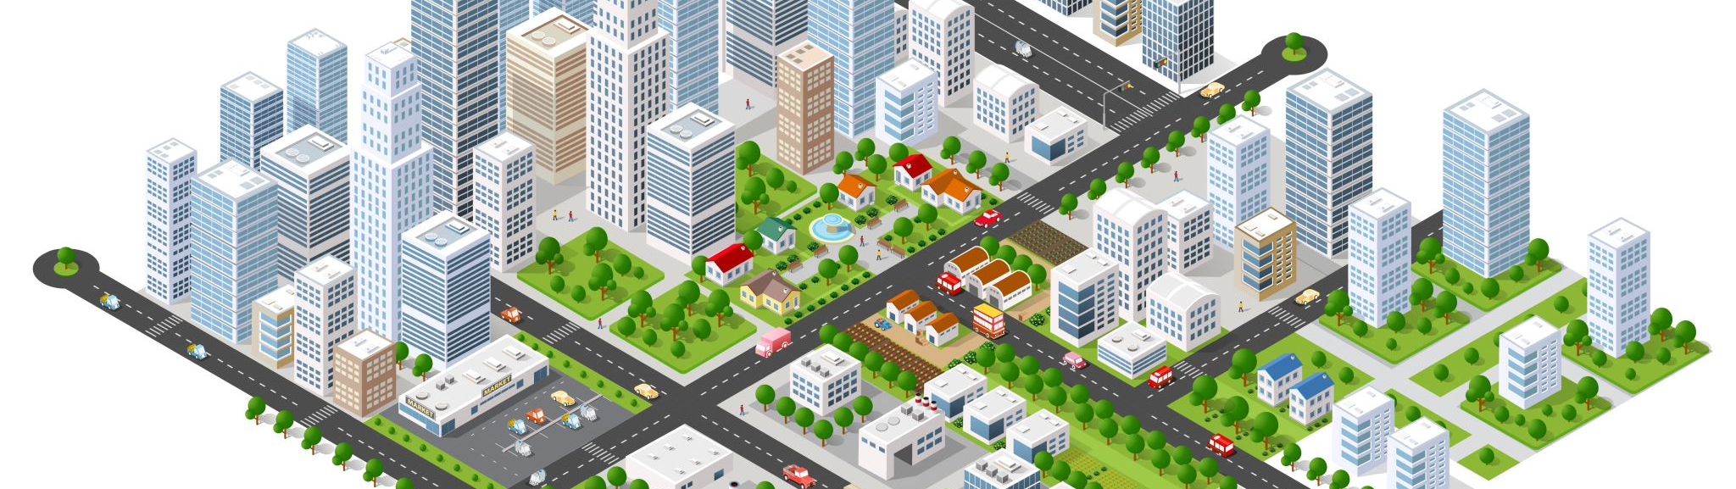
Capital Infrastructure

Slide 53
Roads - 85 miles
(Sycamore to Hammond, IN)
Water pipes - 115 miles
(Sycamore to Davenport, IA)
Sewer pipes - 103 miles
(Sycamore to Madison, WI)
Stormwater – 85 miles
(Sycamore to Stockton, IL)
How Much Infrastructure is the City Responsible for Maintaining?

Slide 54
5-Year Capital Investment Plan (CIP)
Vehicle & Equipment - $5,320,000 ( $1,064,000 per year)
Water Fund - $21,822,500 ( $4,364,500 per year)
Sewer Fund - $5,587,500 ($1,117,500 per year)
Road Construction - $13,466,289 ($2,693,257 per year)
5 Years - $46,196,289 ($9,239,257 per year)

Slide 55
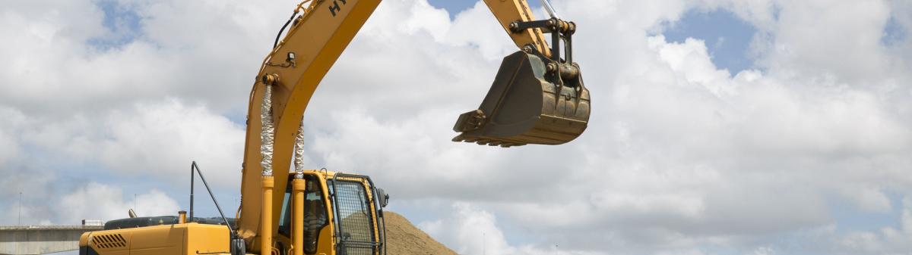
Economic Development

Slide 56
Cities don’t create development.
We position ourselves
to be ready when opportunities arise.

Slide 57
Top Reasons Companies Choose a City
Source: The Brookings Institution
(Center on Urban and Metropolitan Policy)
Workforce: In a survey of business leaders, 72% cited workforce suitability as the top criterion in the selection of a city. (LIMITED CONTROL)
Simplified bureaucracy: permitting process, zoning codes. (DIRECT CONTROL)
Good city infrastructure & Location: (Police, Fire, Water, Sewer, Transportation, Location to Rail or Interstate, Power, and Fiber). (MODERATE CONTROL)
Housing: affordable and convenient housing options. (LIMITED CONTROL)
Generally good quality of life: (Schools, Parks, Recreation). (LIMITED CONTROL)
Tax incentives: Incentives do not create deals, but they do close deals. (DIRECT CONTROL)

Slide 58
What is the role of municipal government in Tax Incentives?
Green (REGULATE) – Lowest risk (Partnership with owners/brokers) Regulate development through zoning, design guidelines, and ordinances. Life – Health – Safety (Setting the Stage)
Yellow (PARTNER) – Medium risk (invest in infrastructure to enhance public realm) PPP / provide public financial assistance
Tools available – TIF, Enterprise Zone, Grants, Loans, and Sales Tax
Red (DIRECT CONTROL)– High risk (Assemble land, guide development on publicly-owned land) Active role in development. The City takes an equity position. City Builds the infrastructure or buys the property.

Slide 59
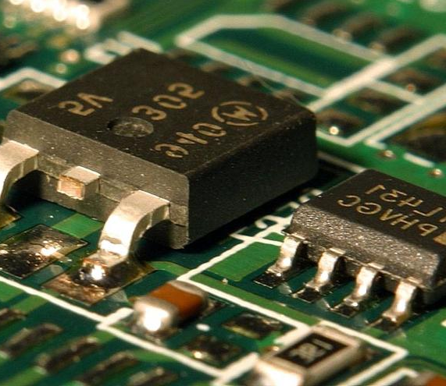
Technology Improvements

Slide 60
Technology Investments Improve Efficiency and Service Delivery
New computers
New faster internet
New phone system
New building inspector software
New work order and fleet management
Digitizing documents
Technology Improvements

Slide 61

Community Engagement

Slide 62

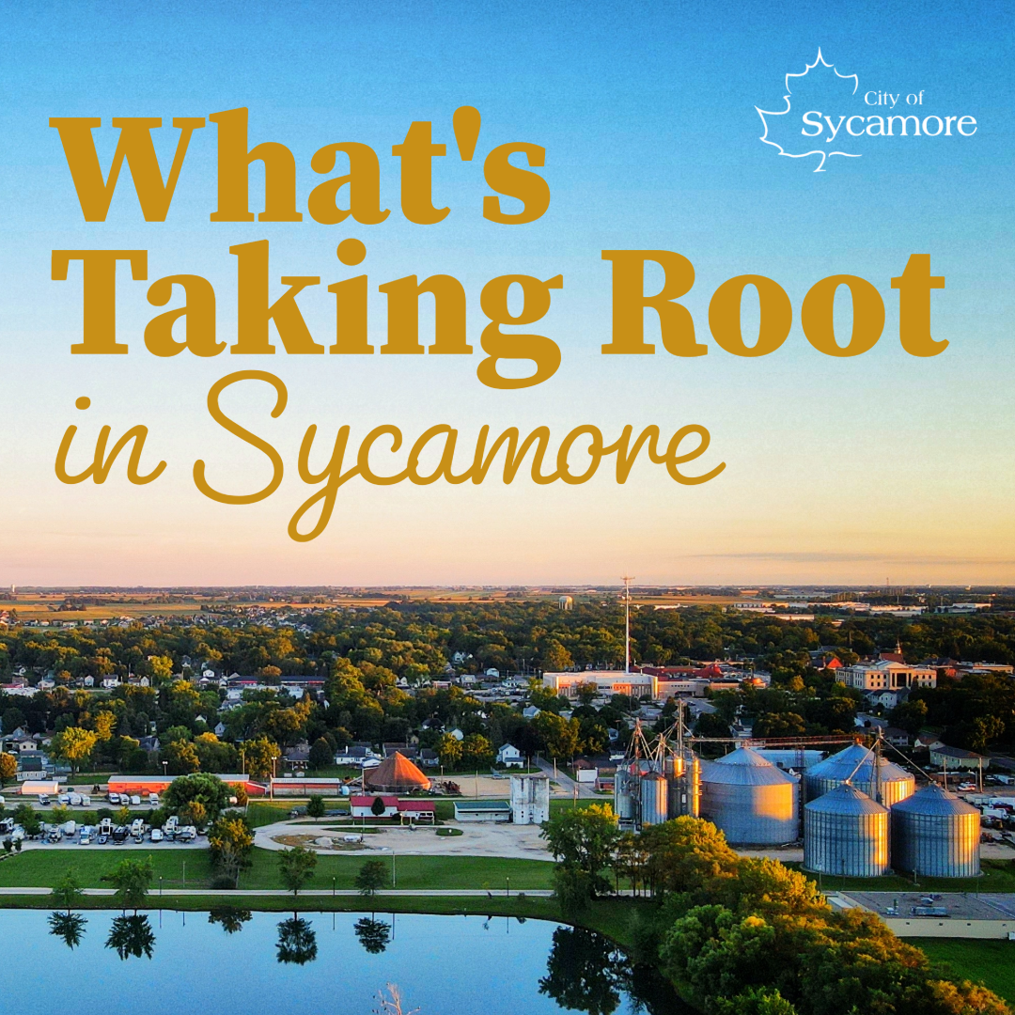
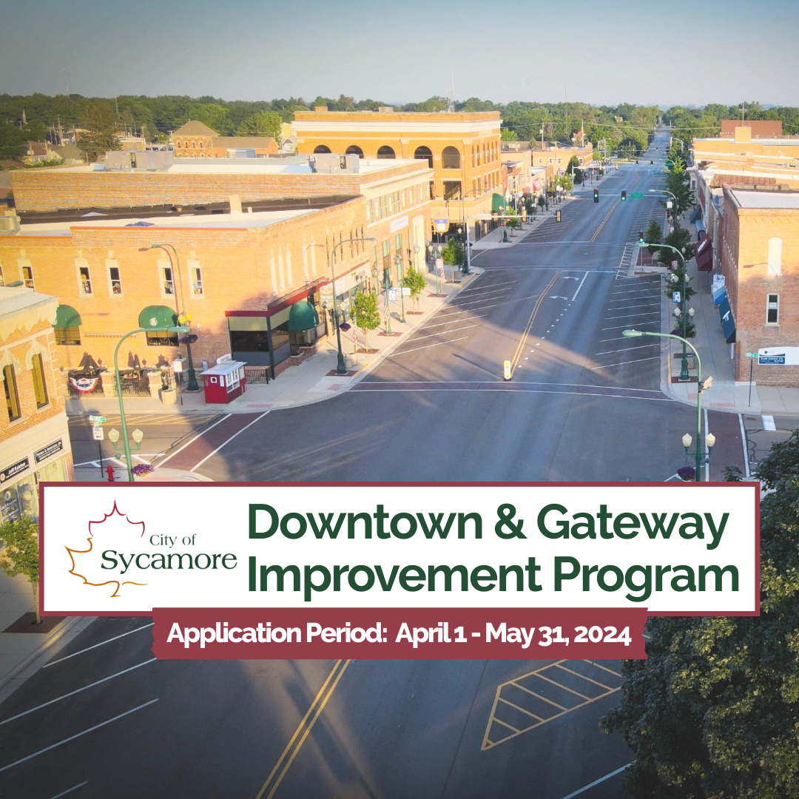

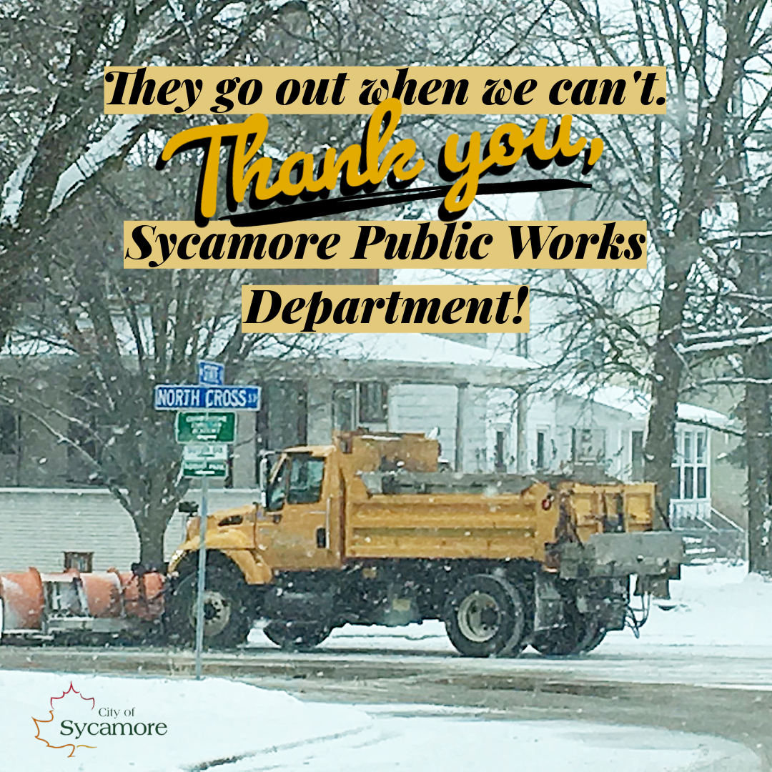
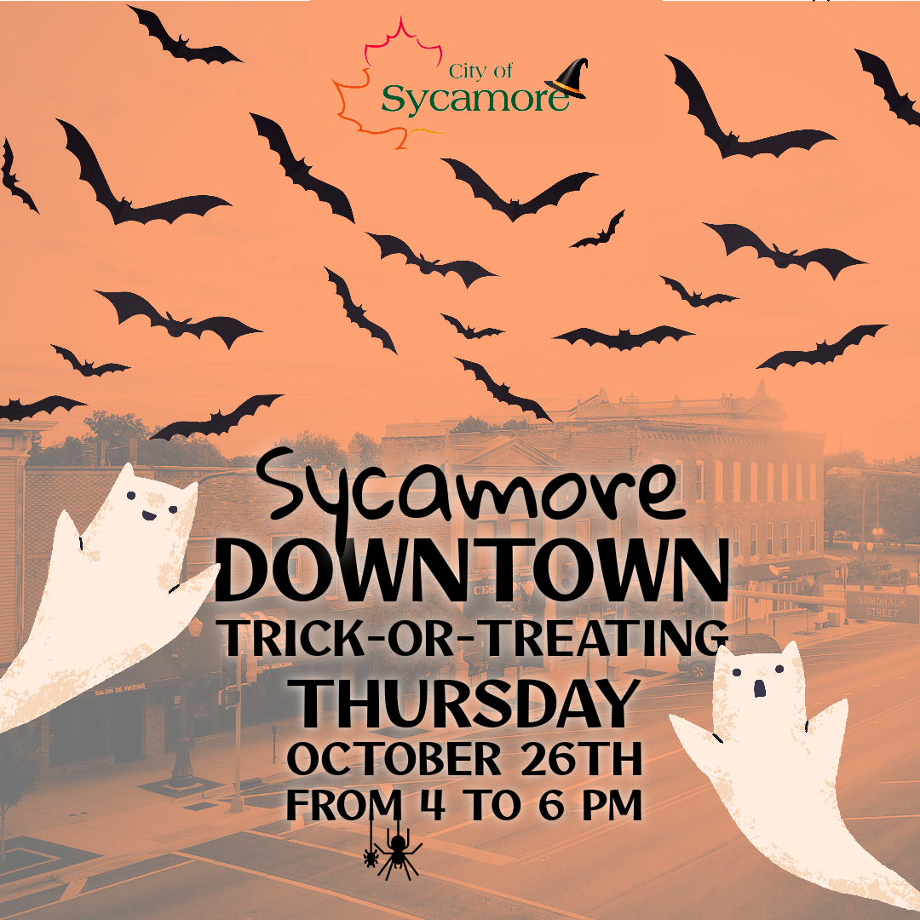
Community Engagement
Website
Social media posts
Inclusion of all material in City Council agenda packets
Attend community events like Pumpkin Fest, music in the park, and street block parties.
Attend and present at Rotary Club, Kiwanis Club, Chamber events, DCEDC, DSATS, and YMCA
Community surveys and presentations
Business conversations
City Council, Committees, Commissions, and Boards

Slide 63
What this means for Sycamore
Sycamore is built on a stable financial foundation supported by local business activity
The City focuses on infrastructure, public safety, and reliable services that support business growth
Our goal is long-term stability, responsible management, and steady economic growth

Slide 64
QUESTIONS?

Slide 65



THANK YOU FOR
JOINING US TODAY!
PRESENTED IN PART BY

